Slide 1



Sale Analysis Dashboard
Insights into Delivery Performance and Optimization
-Presented by Argha Nandi
Email : argha_2312res155@iitp.ac.in

Slide 2
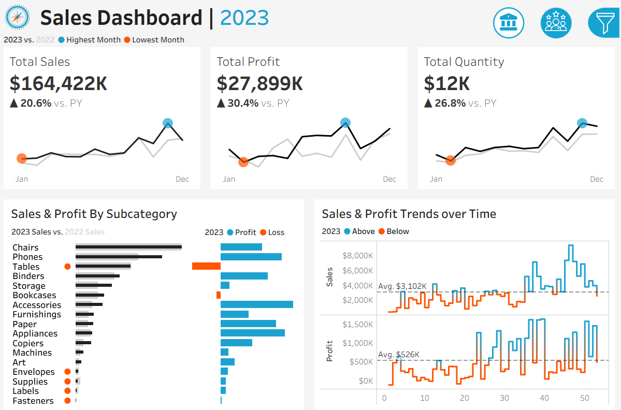
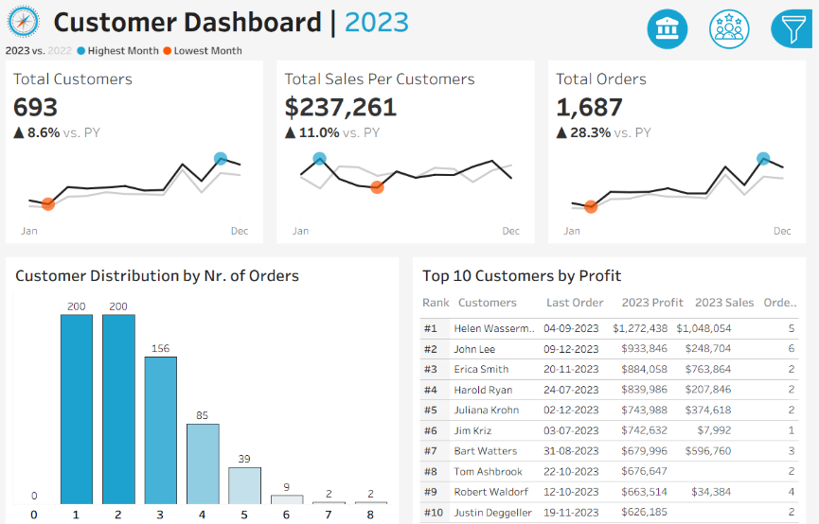
Overview of Dashboard Objectives
This project uses Tableau to analyze sales and customer performance in current year compared to previous year. The dashboards highlight strong growth in sales, profit, and orders, while also uncovering key challenges.

Slide 3
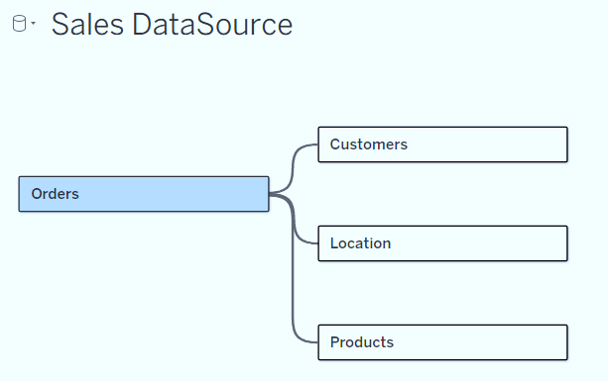
Key Data Sources
The project used four key data sources: Orders.csv (containing sales, profit, quantity, and order dates), Customers.csv (with customer details such as IDs, names, and segments), Products.csv (covering product categories and subcategories), and Location.csv (providing region, state, and city information).

Slide 4
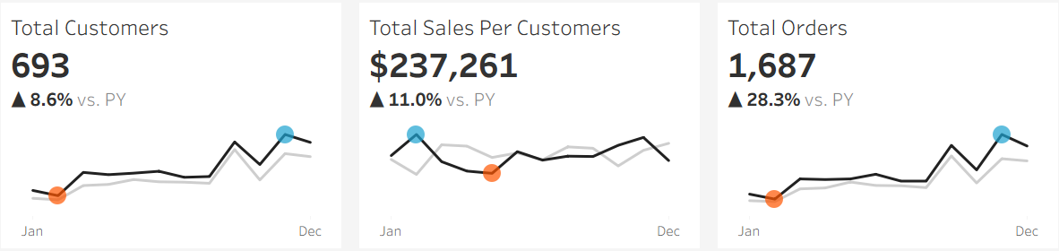
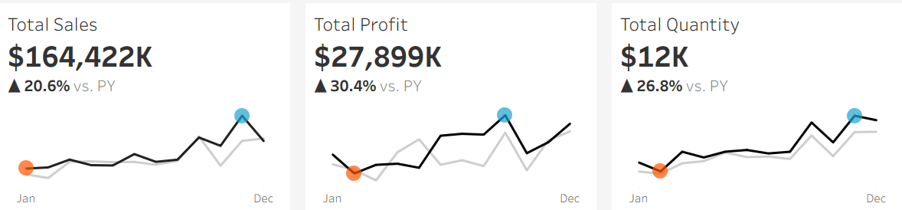
Key Metrices
From these datasets, important metrics such as total sales, profit, quantity sold, number of orders, and unique customers were derived. These metrics were further transformed into meaningful KPIs including year-over-year growth in sales, profit, quantity, customers, and orders, average sales per customer, top customers by profit, and profitability by product subcategory. Together, these KPIs provided actionable insights into overall business performance, product-level profitability, and customer behavior.

Slide 5
Thank you!

